Slide 1


Git + GitHub
A better workflow
- Ankit Kumar
- Aman Kumar

Slide 2
Content
Git
GitHub
GitHub Account
GitHub READMEs
First Contributions
Upload Project
What is Open Source
Why should you contribute
What can you contribute
GitHub Student Developer Pack

Slide 3

What is Git
git is an open source, distributed version control system designed for speed and efficiency

Slide 4
Why are we doing this
Collaboration
Version Control
Showcase your work
Learning and exploring

Slide 5

Git
Git is a version control system.
It keeps a track of changes to your code.
Your changes will be synced with the central repository.
You can collaborate with other developers and work on your code from anywhere.
Git Cheat Sheet
https://education.github.com/git-cheat-sheet-education.pdf

Slide 6
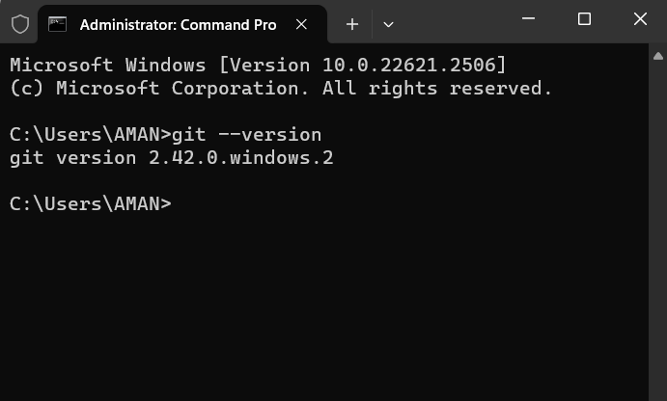
Install Git
Download Git
https://git-scm.com/downloads
Windows CLI
winget install --id Git.Git
Check Installation
git --version

Slide 7
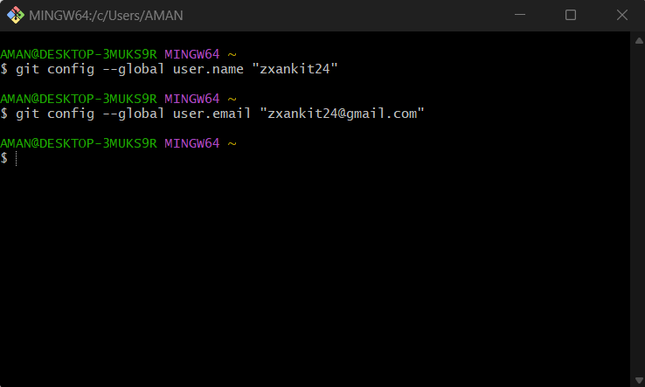
Configure Git
Set Username
git config --global user.name “[firstname lastname]”
Set Email
git config --global user.email “[valid email]”
Check / List config
git config –-global -l

Slide 8
Common Git Commands
Initialize a local repository
git init
Clone a repository from GitHub – creates a local copy of the repo in the location
git clone “Valid URL”
Connect your local repository to the remote repository
git remote add [remote name] [remote URL]
Get all the updates from the remote repository, including new branches.
git fetch

Slide 9
Common Git Commands
Add all files and changes to track
git add .
Commit changes with message
git commit –m [message]
Pull changes from the remote repository
git pull [remote name] [branch name]
Push Changes
git push [remote name] [branch name]

Slide 10

Branches

Slide 11
Branches
Frontend
Web-Dev Project
Deploying
Backend

Slide 12
Branches
A branch in Git is a way to work on a different version of your project without affecting the main branch. This is useful for working on new features, fixing bugs, or testing changes.
See all branches
git branch
Create a new branch and switch to it
git checkout –b [new branch name]
Switch branches
git checkout [branch name]

Slide 13
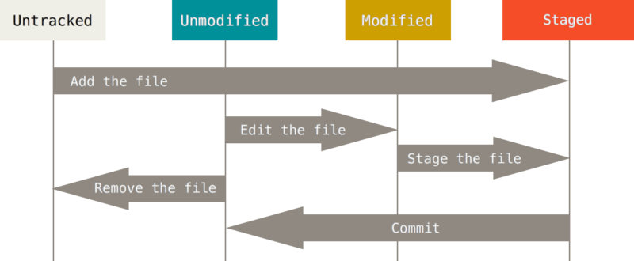
Understand Git

Slide 14


Slide 15

Now why GitHub??

Slide 16


Why
Free and accessible
Collaboration
Showcase your skills
Inclusive

Slide 17


GitHub
GitHub is a website where you can store your code and collaborate with other developers.
It's like a big online filing cabinet for your code.
You can use GitHub to store your personal projects.
You can contribute to open-source projects with GitHub.

Slide 18
GitHub
Let’s create an account
Sign-up to GitHub
https://github.com/signup

Slide 19
GitHub
READMEs as a portfolio

Slide 20
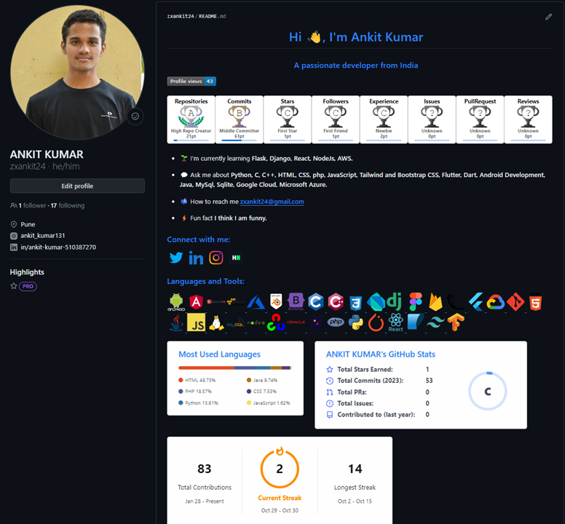
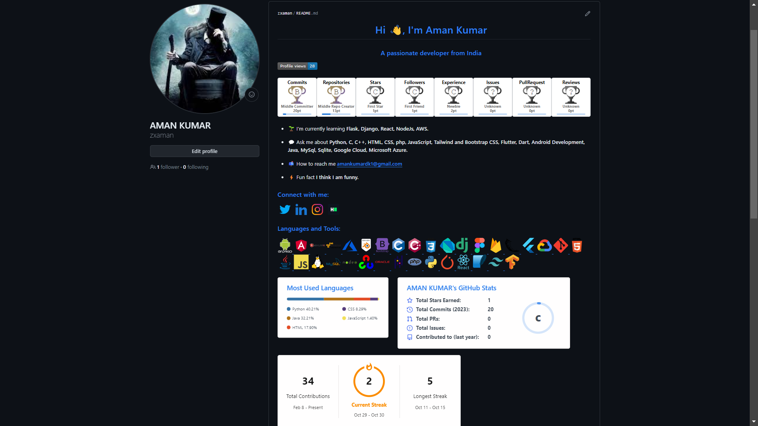


Slide 21
GitHub
Create your first repository

Slide 22
GitHub
Upload Projects

Slide 23
Open-Source

Slide 24
What is Open Source Software
Open-source software is software with source code that anyone can inspect, modify, and enhance.
Open-source projects, products, or initiatives embrace and celebrate principles of open exchange.
There is open collaborative participation, rapid prototyping and transparency.
Development is community-oriented.
Ex – Linux, Git, Python, Apache Web Server, Appwrite and many more

Slide 25
GitHub Student Developer Pack
GitHub Education – Join Global Campus
https://education.github.com/
Student Developer Pack
https://education.github.com/pack/

Slide 26

PPT Link…

Slide 27

Thank you!
Ankit & Aman

